Slide 1
The Importance of
Software in Business
High
Software
$
Hardware
Low
1950
today
time

Slide 2
Classes of Software
Systems software
  Set of programs that coordinates activities and functions of the hardware and various other programs
Application software
  Programs that help users solve particular computing problems

Slide 3
Role of Systems Software
System software…
  Is an interface or buffer between application software and hardware
  Controls the computer hardware and acts as an interface with applications programs
Schematic

Slide 4

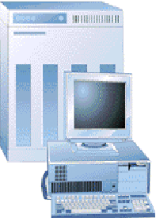
Application
software
Operating
and
systems
software
Users
Hardware

Slide 5
What Is An Operating System
A modern computer consists of:
One or more processors
Main memory
Disks
Printers
Various input/output devices
Managing all these components requires a layer of software – the operating system
Tanenbaum, Modern Operating Systems 3 e, (c) 2008 Prentice-Hall, Inc. All rights reserved. 0-13-6006639
Notes:
A modern computer is a complex system. It’s impossible for every application programmer to understand how all these thing work in detail. Furthermore, managing all these components and using them optimally is an exceedingly challenging job.
therefore, OS is introduced to provide user programs with a better, simpler, cleaner model of the computer and handle all the resources.
User uses various kinds of OS.

Slide 6
Introduction:
An Operating System (OS) is an interface between a computer user and computer hardware. An operating system is a software which performs all the basic tasks like file management, memory management, process management, handling input and output, and controlling peripheral devices such as disk drives and printers.
Some popular Operating Systems include Linux, Windows, OS X, VMS, OS/400, AIX, z/OS, etc.

Slide 7
The primary objectives of operating system Are as follows:
1:Making the computer system convenient to use.
Os manages all parts of the system and presents the user with interface which is easier to program and use.so it hides details about hardware.
2:Managing the resources of a computer system:The objectives of an operating system is to manage various resources of the computer system,this involves performing such tasks as keeping track of who is using which resources, granting resources request.

Slide 8
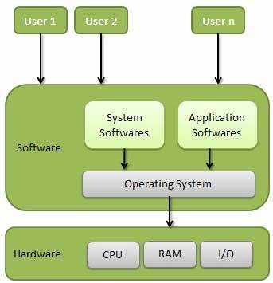

Definition
An operating system is a program that acts as an interface between the user and the computer hardware and controls the execution of all kinds of programs.

Slide 9
What is an operating system?
Two functions:
  From top to down: provide application programmers a clean abstract set of resources instead of hardware ones
  From down to top: Manage these hardware resources

Slide 10
functions of an operating System.
Memory Management
Processor Management
Device Management
File Management
Security
Control over system performance
Job accounting
Error detecting aids
Coordination between other software and users

Slide 11
Operating System Functions
  Perform common computer hardware functions
  Provide a user interface
  Provide a degree of hardware independence
  Manage system memory
  Manage processing tasks
  Provide networking capability
  Control access to system resources
  Manage files

Slide 12
Following are a few common services provided by an operating system −
Program execution
I/O operations
File System manipulation
Communication
Error Detection
Resource Allocation
Protection

Slide 13
Memory Management
Memory management refers to management of Primary Memory or Main Memory. Main memory is a large array of words or bytes where each word or byte has its own address.
Main memory provides a fast storage that can be accessed directly by the CPU. For a program to be executed, it must in the main memory. An Operating System does the following activities for memory management −
Keeps tracks of primary memory, i.e., what part of it are in use by whom, what part are not in use.
In multiprogramming, the OS decides which process will get memory when and how much.
Allocates the memory when a process requests it to do so.
De-allocates the memory when a process no longer needs it or has been terminated.

Slide 14
Processor Management
In multiprogramming environment, the OS decides which process gets the processor when and for how much time. This function is called process scheduling. An Operating System does the following activities for processor management −
Keeps tracks of processor and status of process. The program responsible for this task is known as traffic controller.
Allocates the processor (CPU) to a process.
De-allocates processor when a process is no longer required.

Slide 15
Device Management
An Operating System manages device communication via their respective drivers. It does the following activities for device management −
Keeps tracks of all devices. Program responsible for this task is known as the I/O controller.
Decides which process gets the device when and for how much time.
Allocates the device in the efficient way.
De-allocates devices.

Slide 16
File Management
A file system is normally organized into directories for easy navigation and usage. These directories may contain files and other directions.
An Operating System does the following activities for file management −
Keeps track of information, location, uses, status etc. The collective facilities are often known as file system.
Decides who gets the resources.
Allocates the resources.
De-allocates the resources.

Slide 17
Security − By means of password and similar other techniques, it prevents unauthorized access to programs and data.
Control over system performance − Recording delays between request for a service and response from the system.
Job accounting − Keeping track of time and resources used by various jobs and users.
Error detecting aids − Production of dumps, traces, error messages, and other debugging and error detecting aids.
Coordination between other softwares and users − Coordination and assignment of compilers, interpreters, assemblers and other software to the various users of the computer systems.

Slide 18
Classification of operating system:
1 Multi-user system: Multi-user operating system also called time sharing system which serves more than one user using the system simultaneously. Each user works on terminal connected to main computer. multi-user operating system maintain a list of authorized users and provides password protection to an authorized users who may try to gain access to the system. so some operating system permit hundreds and even thousand of users at a time. For example: windows, Linux, Mac, etc.

Slide 19
Multiprocessing OS:
A multiprocessing OS can support the execution of multiple processes at the same time. It uses multiple number of CPU. It is expensive in cost however, the processing speed will be faster. It is complex in its execution. Operating system like Unix, 64 bit edition of windows, server edition of windows, etc. are multiprocessing.
Multiprogramming OS:
In a multiprogramming OS more than one programs can be used at the same time. It may or may not be multiprocessing. In a single CPU system , multiple program are executed one after another by dividing the CPU into small time slice.
example: Windows, Mac, Linux,etc.

Slide 20
An OS does the following activities related to multiprogramming.
The operating system keeps several jobs in memory at a time.
This set of jobs is a subset of the jobs kept in the job pool.
The operating system picks and begins to execute one of the jobs in the memory.
Multiprogramming operating systems monitor the state of all active programs and system resources using memory management programs to ensures that the CPU is never idle, unless there are no jobs to process.
Multiprogramming Contd..
Advantages
High and efficient CPU utilization.
User feels that many programs are allotted CPU almost simultaneously.
Disadvantages
CPU scheduling is required.
To accommodate many jobs in memory, memory management is required

Slide 21
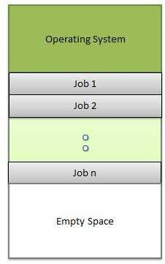

Slide 22
Multitasking OS( Time Sharing OS):
In a multitasking system more than one task can be performed at the same time but they are executed one after another through a single CPU by time sharing. For example: Windows, Linux, Mac, Unix,etc.
Multitasking OS are of two types:
a) Pre-empetive multitasking
b) Co-operative multitasking
In the pre-empetive multitasking, the OS allows CPU times slice to each program. After each time slice, CPU executes another task. Example: Windows XP
In co-operative multitasking a task can control CPU as long as it requires . However, it will free CPU to execute another program if it doesn’t require CPU. Exaample: windows 3.x
Multithreading:
A program in execution is known as process. A process can be further divided into multiple sub-processes. These sub-processers are known as threads. A multi-threading OS can divide process into threads and execute those threads. This increases operating speed but also increases the complexity. For example: Unix, Server edition of Linux and windows.

Slide 23
Multitasking is when multiple jobs are executed by the CPU simultaneously by switching between them. Switches occur so frequently that the users may interact with each program while it is running. An OS does the following activities related to multitasking −
The user gives instructions to the operating system or to a program directly, and receives an immediate response.
The OS handles multitasking in the way that it can handle multiple operations/executes multiple programs at a time.
Multitasking Operating Systems are also known as Time-sharing systems.
These Operating Systems were developed to provide interactive use of a computer system at a reasonable cost.
A time-shared operating system uses the concept of CPU scheduling and multiprogramming to provide each user with a small portion of a time-shared CPU.
Each user has at least one separate program in memory.

Slide 24
Time sharing system
A time sharing system allows many users to share the computer resources simultaneously. In other words, time sharing refers to the allocation of computer resources in time slots to several programs simultaneously. For example a mainframe computer that has many users logged on to it. Each user uses the resources of the mainframe -i.e. memory, CPU etc. The users feel that they are exclusive user of the CPU, even though this is not possible with one CPU i.e. shared among different users.
The time sharing systems were developed to provide an interactive use of the computer system. A time shared system uses CPU scheduling and multiprogramming to provide each user with a small portion of a time-shared computer. It allows many users to share the computer resources simultaneously. As the system switches rapidly from one user to the other, a short time slot is given to each user for their executions.

Slide 25
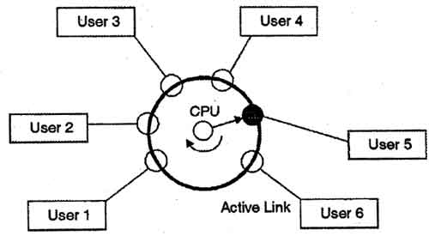
The time sharing system provides the direct access to a large number of users where CPU time is divided among all the users on scheduled basis. The OS allocates a set of time to each user. When this time is expired, it passes control to the next user on the system. The time allowed is extremely small and the users are given the impression that they each have their own CPU and they are the sole owner of the CPU. This short period of time during that a user gets attention of the CPU; is known as a time slice or a quantum. The concept of time sharing system is shown in figure.
In above figure the user 5 is active but user 1, user 2, user 3, and user 4 are in waiting state whereas user 6 is in ready status.

Slide 26
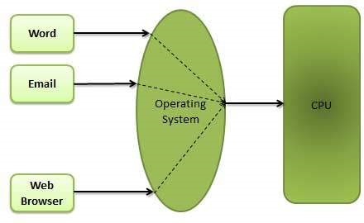
Multitasking:

Slide 27
Batch Processing:
A batch processing is a group of processing system in which all the required input of all the processing task is provided initially. The result of all the task is provided after the completion of all the processing.
. An operating system does the following activities related to batch processing −
The OS defines a job which has predefined sequence of commands, programs and data as a single unit.
The OS keeps a number a jobs in memory
Jobs are processed in the order of submission, i.e., first come first served fashion.
When a job completes its execution, its memory is released and the output for the job gets copied into an output spool for later printing or processing.

Slide 28
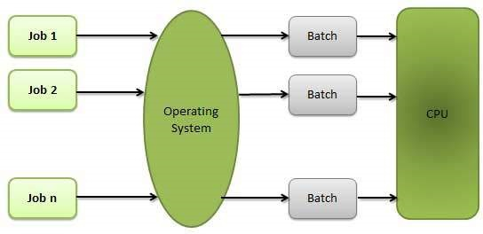

Slide 29
Real Time System
Real-time systems are usually dedicated, embedded systems. An operating system does the following activities related to real-time system activity.
In such systems, Operating Systems typically read from and react to sensor data.
The Operating system must guarantee response to events within fixed periods of time to ensure correct performance.
They have well-defined time constraints, processing must be done within the defined time constraints otherwise the system will fail.e.g-p-855,BLMX are real-time operating system.

Slide 30
Real-time systems are used when there are rigid time requirements on the operation of a processor or the flow of data and real-time systems can be used as a control device in a dedicated application. A real-time operating system must have well-defined, fixed time constraints, otherwise the system will fail. For example, Scientific experiments, medical imaging systems, industrial control systems, weapon systems, robots, air traffic control systems, etc.

Slide 31
There are two types of real-time operating systems.
Hard real-time systems
Hard real-time systems guarantee that critical tasks complete on time. In hard real-time systems, secondary storage is limited or missing and the data is stored in ROM. In these systems, virtual memory is almost never found.
Soft real-time systems
Soft real-time systems are less restrictive. A critical real-time task gets priority over other tasks and retains the priority until it completes. Soft real-time systems have limited utility than hard real-time systems. For example, multimedia, virtual reality, Advanced Scientific Projects like undersea exploration and planetary rovers, etc.

Slide 32
Network operating System
A Network Operating System runs on a server and provides the server the capability to manage data, users, groups, security, applications, and other networking functions. The primary purpose of the network operating system is to allow shared file and printer access among multiple computers in a network, typically a local area network (LAN), a private network or to other networks.
Examples of network operating systems include Microsoft Windows Server 2003, Microsoft Windows Server 2008, UNIX, Linux, Mac OS X, Novell NetWare, and BSD.

